Slide 1







Emerging Technology Trends: An In-Depth Analysis of Global IT Skills Demand
Data Analyst Capstone Project Presentation
Bilal BOUDJEMA
04/01/2024

Slide 2



OUTLINE
Executive Summary
Introduction
Methodology
Results
Visualization – Charts
Dashboard
Discussion
Findings & Implications
Conclusion
Appendix

Slide 3

EXECUTIVE SUMMARY Executive Summary: Technology Skills Demand Analysis
Overview of Study: A comprehensive analysis of current and emerging technology trends in the global IT and Business Services sector.
Key Objectives: To identify the most in-demand technology skills and understand the evolving landscape of IT expertise requirements.
Methodology: Utilized a combination of data collection methods, including analysis of job postings, tech blog reviews, and industry surveys.
Major Findings:
A significant rise in demand for skills in areas such as AI, Machine Learning, and Big Data analytics.
The growing importance of full-stack development capabilities and cloud computing expertise.
A notable shift towards the adoption of Agile and DevOps methodologies in software development.
Demographic Insights: Highlighted gender and age distribution trends among technology professionals, reflecting diversity in the tech workforce.
Visualization and Analysis Tools: Use of advanced data visualization techniques and IBM Cognos for dynamic and interactive data representation.
Implications for Stakeholders: Essential insights for IT professionals, educators, and industry leaders for strategic planning in skill development and training programs.
Future Outlook: Predictions on evolving technology trends and recommendations for staying competitive in the rapidly changing IT industry.
Innovative Elements: Incorporation of interactive dashboards and a storytelling approach to make the data more accessible and engaging.

Slide 4

INTRODUCTION
Purpose of the Report: This report presents an exhaustive analysis of current and emerging technology trends, focusing on the skills most in demand within the global IT and business services sector.
Audience: The primary audience for this report includes IT professionals, industry analysts, and educational institutions looking to align their curriculum with market demands.
Value Proposition: By reading this report, stakeholders will gain insights into the most sought-after technology skills, enabling informed decision-making for career development, hiring, and training strategies.
Project Overview: As part of the Capstone project for the Data Analyst Professional Certificate, this report is a culmination of comprehensive data analysis, reflecting real-world IT industry demands and trends.

Slide 5

METHODOLOGY
Data Collection: Data was meticulously gathered from diverse sources such as job postings, tech blogs, and industry surveys.
Data Preparation: Employing advanced data wrangling techniques including identification and handling of duplicates, addressing missing values, and data normalization.
Analytical Techniques: Utilization of statistical methods to identify key trends such as top programming languages, in-demand database skills, and demographic distributions in the tech sector.
Visualization Tools: Selection of effective visualization techniques, including charts, plots, and histograms, complemented by the use of IBM Cognos for dynamic dashboard creation.

Slide 6
RESULTS

Slide 7
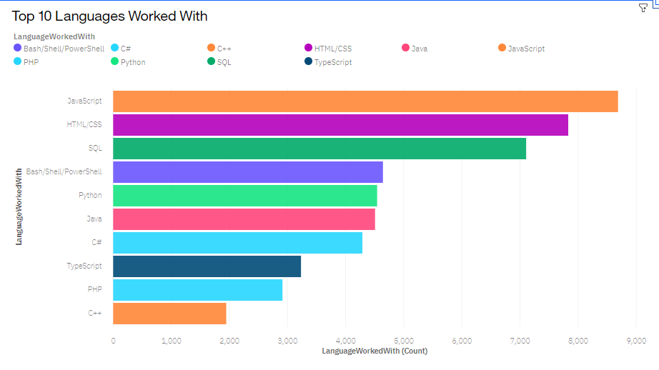
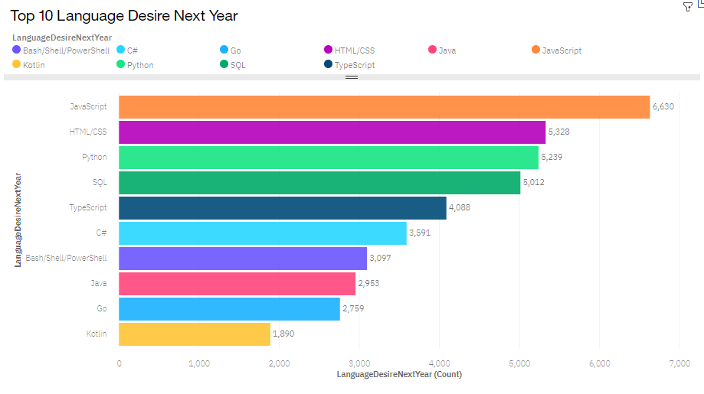
PROGRAMMING LANGUAGE TRENDS
Current Year
Next Year

Slide 8
PROGRAMMING LANGUAGE TRENDS - FINDINGS & IMPLICATIONS
Findings
JavaScript is currently the most utilized programming language, followed by HTML/CSS and SQL, indicating a strong trend towards web development skills.
Python holds a significant place in both current usage and desired skills for the next year, reflecting its importance in emerging fields like data science and machine learning.
The demand for Bash/Shell/PowerShell indicates a consistent need for scripting and automation capabilities within IT workflows.
Notably, Kotlin appears as a language with a growing interest for the next year, suggesting an increasing development trend in Android app development.

Slide 9
PROGRAMMING LANGUAGE TRENDS - FINDINGS & IMPLICATIONS
Implications for stakeholders
For Educators: Curriculum development should emphasize JavaScript, HTML/CSS, SQL, and Python to align with current market demands.
For IT Professionals: Upskilling in Python and Kotlin may provide competitive advantages in the job market, considering their projected increased demand.
For Recruiters and Hiring Managers: A focus on candidates with strong web development and scripting skills will be crucial to meet current IT project requirements.
For Industry Analysts: Monitoring the trajectory of Kotlin and other emerging languages is essential to anticipate shifts in the technology landscape.
For Developers: Engaging with JavaScript, HTML/CSS, and Python appears to be most beneficial for immediate opportunities, while learning Kotlin could be strategic for future growth.

Slide 10
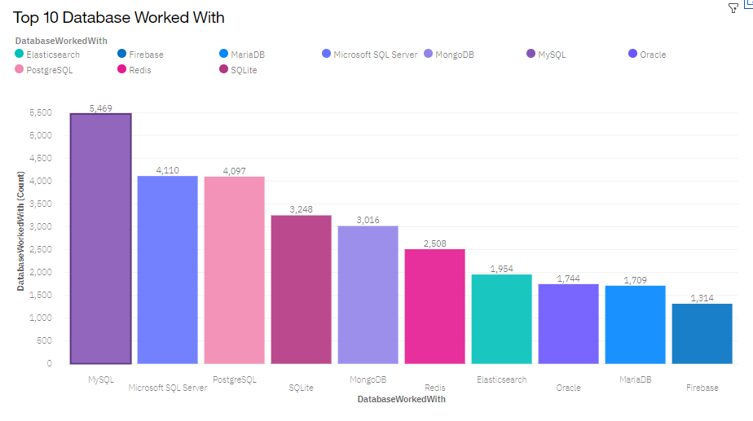
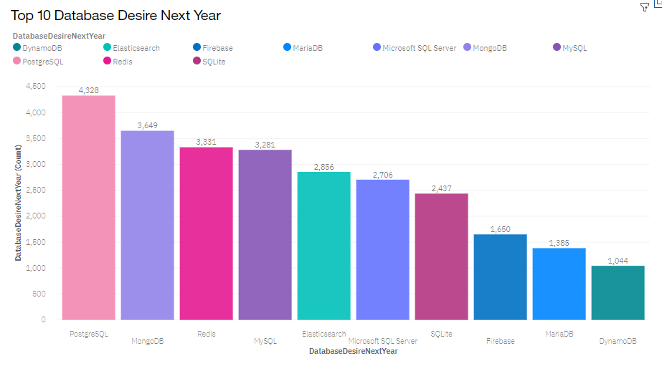
DATABASE TRENDS
Current Year
Next Year

Slide 11
DATABASE TRENDS - FINDINGS & IMPLICATIONS
Database Usage - Current Findings:
MySQL is the most used database, indicating its widespread adoption and the importance of SQL knowledge.
Microsoft SQL Server and PostgreSQL follow closely, reflecting the need for diverse relational database management skills.
MongoDB's presence highlights the significant use of NoSQL databases in the industry.
Redis and Elasticsearch are also prominent, suggesting a trend toward in-memory data stores and search engines

Slide 12
DATABASE TRENDS - FINDINGS & IMPLICATIONS
Implications for the Tech Industry:
For IT Professionals: Mastery of MySQL remains critical, with a strong emphasis on understanding both Microsoft SQL Server and PostgreSQL for career advancement.
For Companies & Startups: There is a clear indication of the growing interest in PostgreSQL and MongoDB, signaling a potential shift in the database landscape and the need to adapt to these technologies.
For Educational Institutions: Courses should be updated to not only cover relational databases but also include NoSQL options like MongoDB, and technologies like Redis and Elasticsearch to meet the demands of modern applications.
For Developers: Keeping up-to-date with both SQL and NoSQL databases is advisable, as the desire for PostgreSQL and MongoDB expertise is projected to grow.
For Data Architects: Designing flexible systems that can integrate with various database types, including in-memory and search engine databases, will be increasingly important.

Slide 13

DASHBOARD
Dashboard Link:
https://dataplatform.cloud.ibm.com/dashboards/c6e3aba0-53cd-4948-876b-2f59753c3170/view/6317d10000ef15cc4beabde4079d2b547e3e235bb6bbd55188827b4906682797a96f1a92c8274b5e8b170231f5e5135ac8

Slide 14
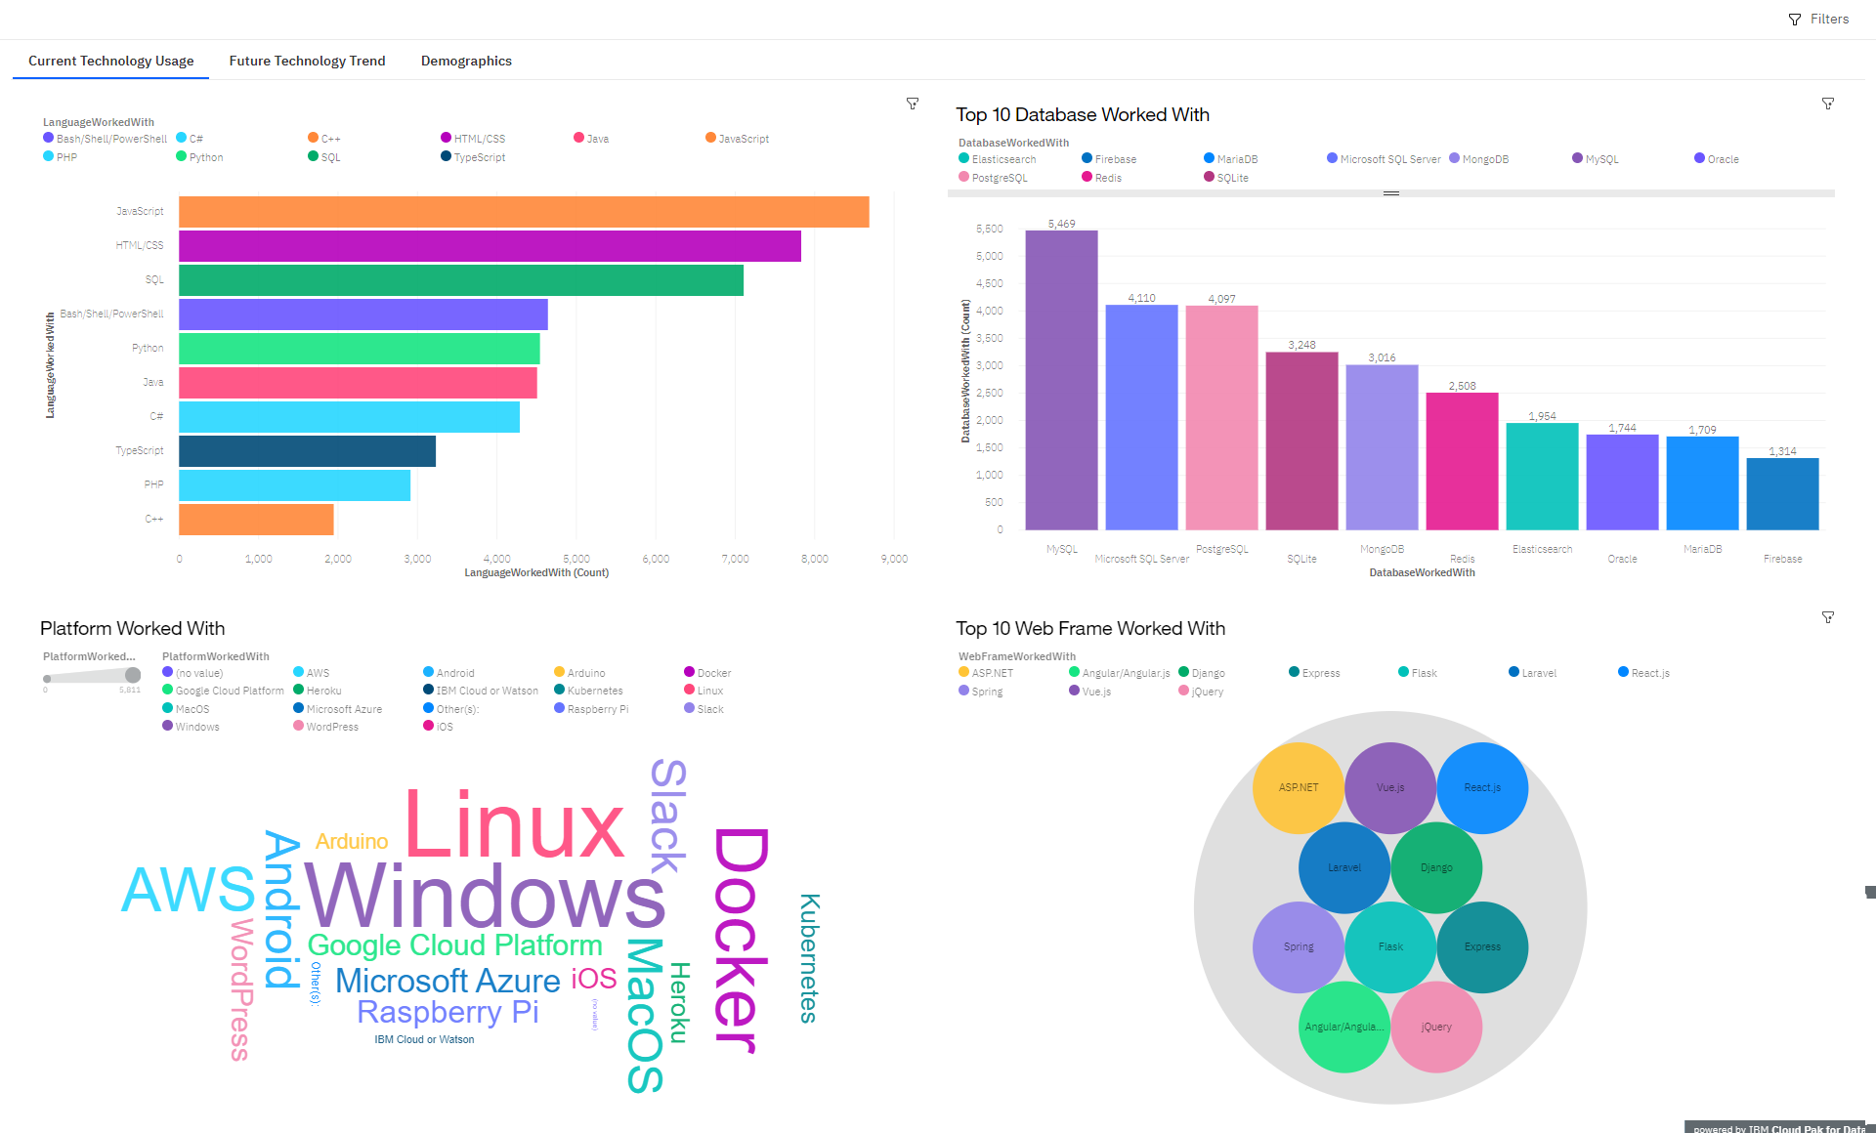
DASHBOARD TAB 1

Slide 15
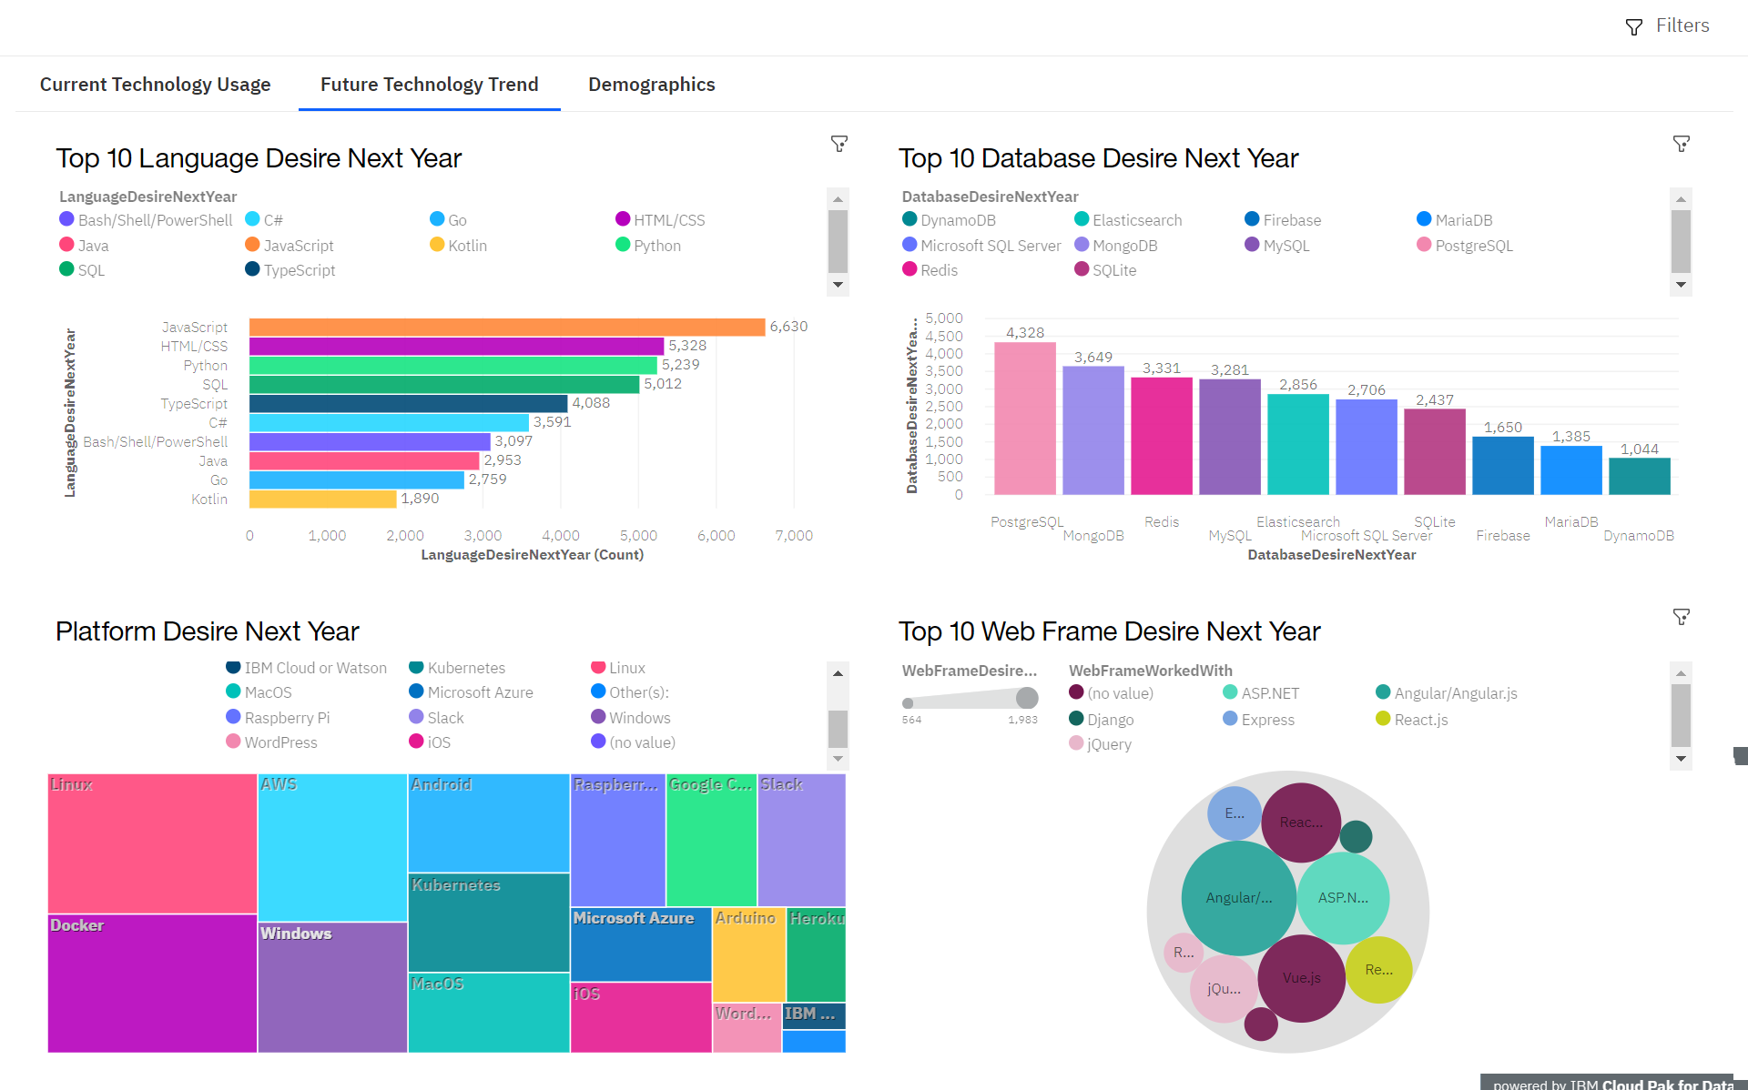
DASHBOARD TAB 2

Slide 16
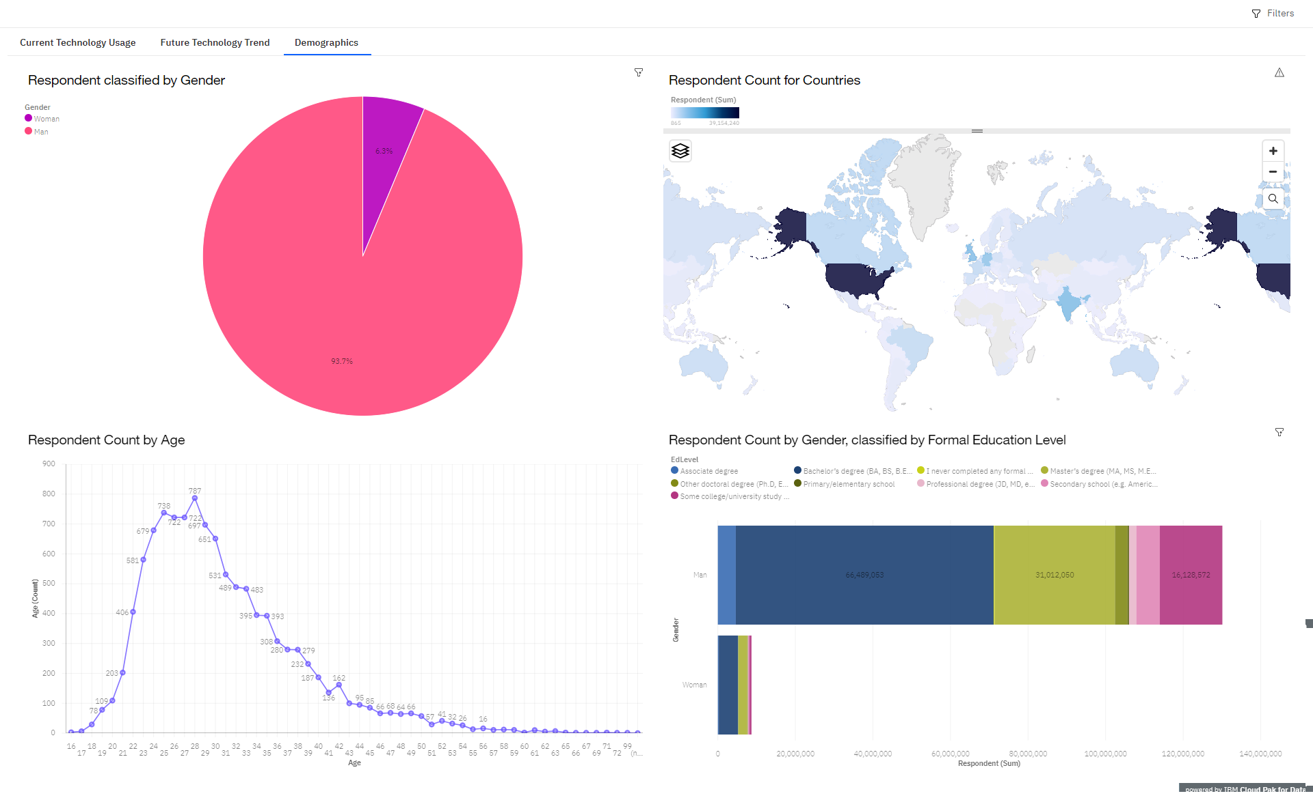
DASHBOARD TAB 3

Slide 17
DISCUSSION

Slide 18
OVERALL FINDINGS & IMPLICATIONS
Findings
Dominance of JavaScript and SQL points to the vitality of web technologies.
Rising interest in Python and Kotlin signals a tilt towards data science and mobile development.
PostgreSQL’s growing desirability suggests a shift towards scalable database solutions.
MongoDB and Redis reflect the increased need for flexible, non-relational databases.
Implications
Educators should emphasize a curriculum that integrates both established and emerging technologies.
IT professionals must adapt to the evolving landscape by expanding their skill sets.
Organizations need to align hiring and training to encompass a broad spectrum of IT competencies.

Slide 19

CONCLUSION
Web development, particularly with JavaScript and SQL, remains fundamental in the IT skill set.
Python's versatility across various domains underscores its importance for future-proofing careers.
The projected rise in PostgreSQL and NoSQL databases like MongoDB suggests a shift towards scalable and flexible data management systems.
A growing interest in Kotlin points to the increasing relevance of mobile development skills.
IT professionals and educators should proactively adapt to these trends for sustained relevance in the evolving tech ecosystem.

Slide 20

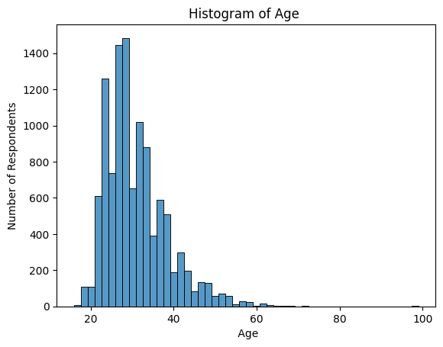
APPENDIX
Age Of Respondent

Slide 21
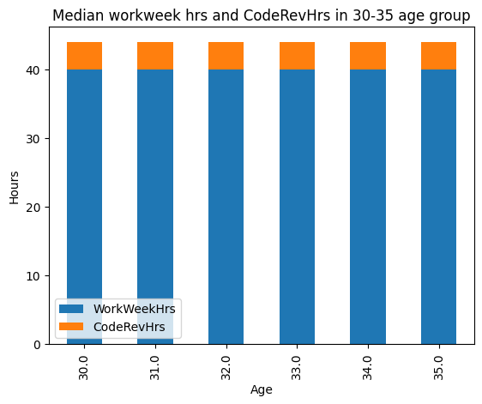
APPENDIX
Median WorkWeek Hours and CodeRev in 30-35 age group

Slide 22
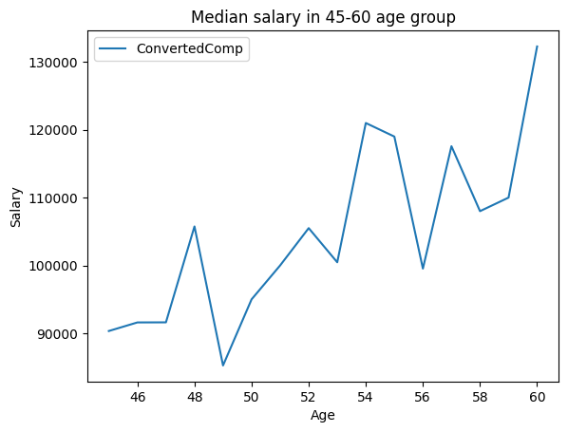
APPENDIX
Median Salary in 45-60 age group

Slide 23
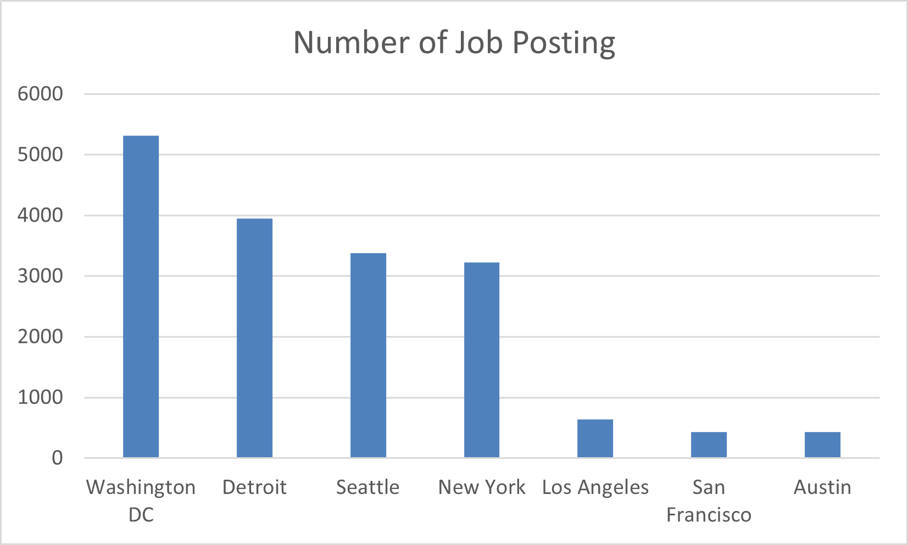
JOB POSTINGS

Slide 24
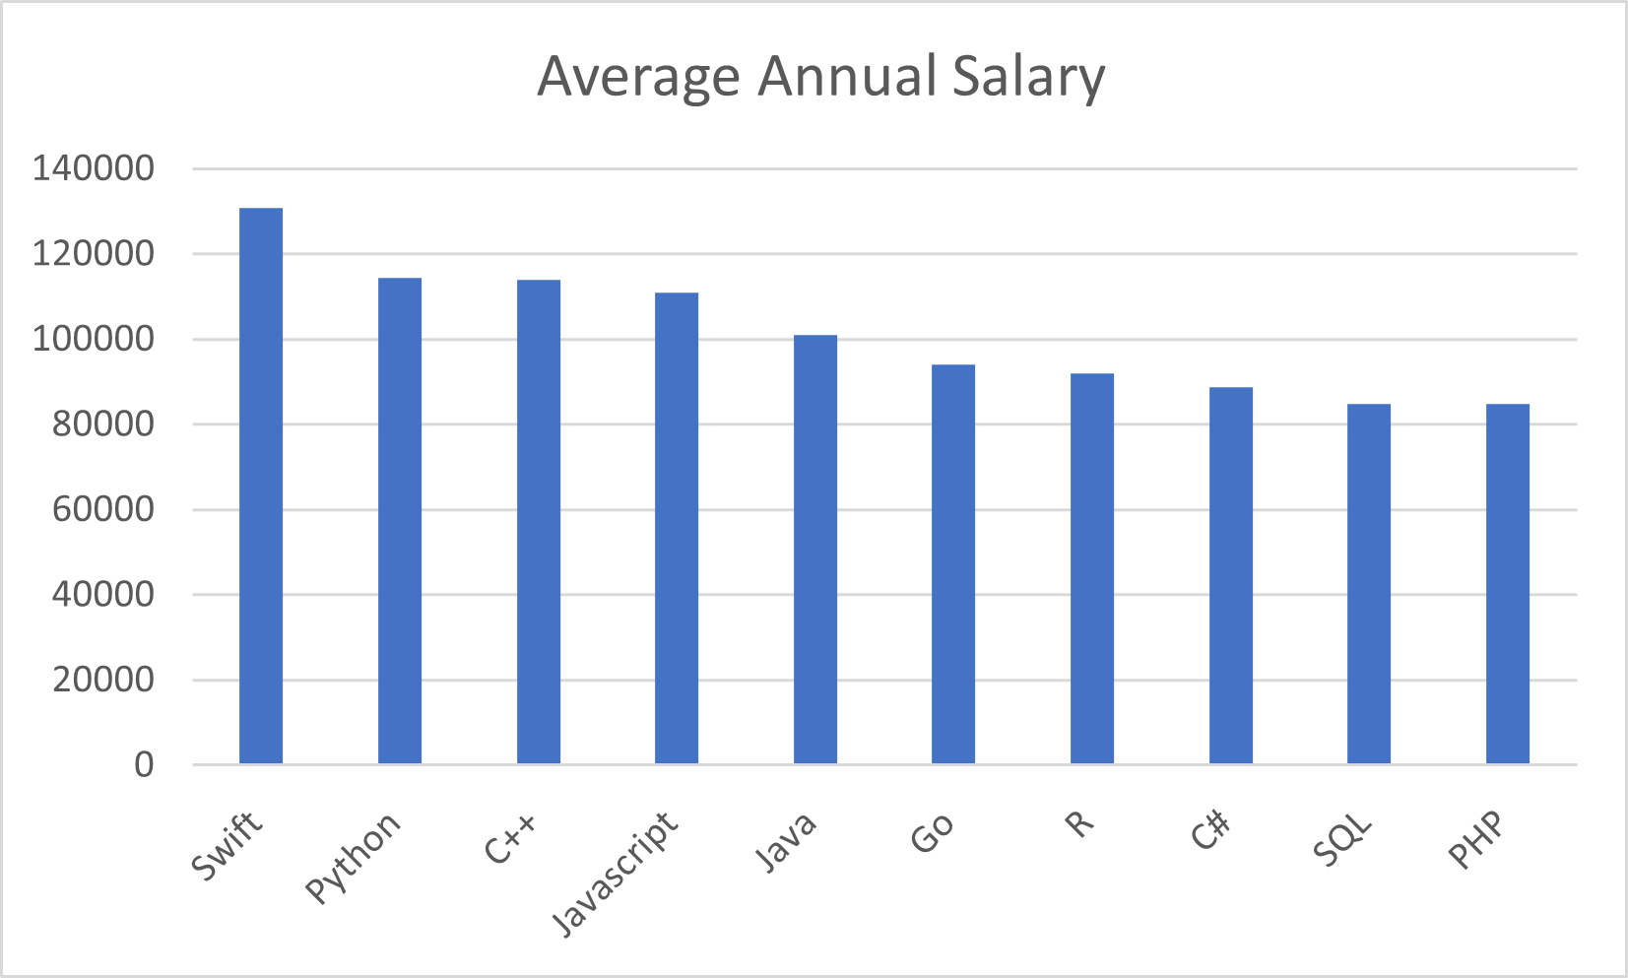
POPULAR LANGUAGES

Slide 25
Interactive Q&A Session
Engage Live: Submit your questions in the chat or raise your hand to speak.
Upvote Questions: Use the 'like' feature to upvote the questions you most want answered.
Question:1 "Given the rising interest in PostgreSQL, what would be the most efficient way for a professional experienced in MySQL to transition to PostgreSQL?"
Question:2 "With the diversity of programming languages in demand, how should IT departments prioritize which languages to include in their training for new hires?"
Time Allocated: 15 minutes - Your time is valuable, let's make the most of it.
Feedback: Share your session experience via the feedback form.

